Slide 1
Library prep QC
Rapid Response – Updated July 2026

Slide 2
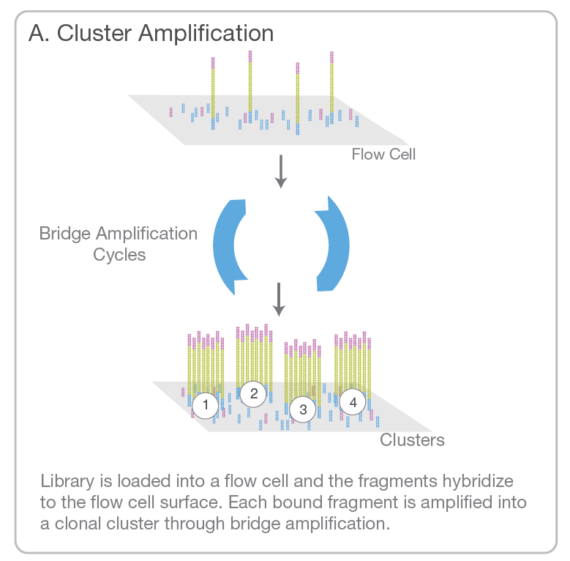
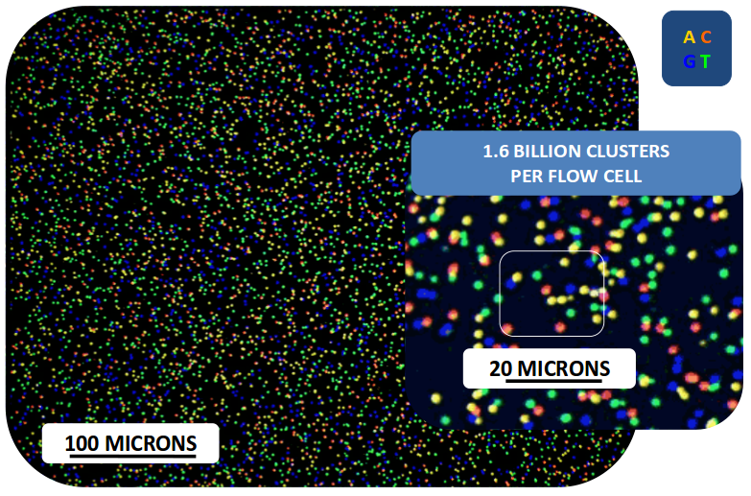
Cluster amplification is essential for Illumina sequencing
~ loading concentration
~ fragment length

Slide 3
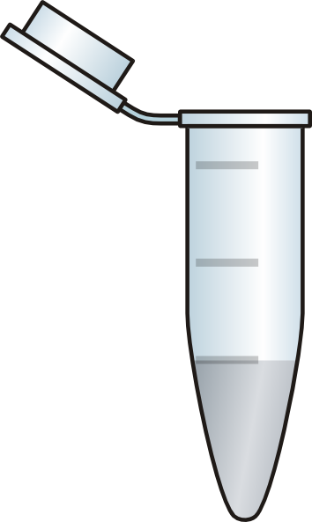

Library prep QC
QC 1
Sample A
Individual library QC passed?
YES
QC 2
YES
Final QC
passed?
Individual library QC passed?
Pool
YES
Sample B
YES
Water control A
Individual library QC passed?
Notes:
Two moments during lib prep to do QC: individual library and pooled library

Slide 4

Library prep QC
Concentration
Length
Remove adapter dimers
vs
vs
vs
or
Notes:
: Ct <15: dilute 1/10, rest use undiluted

Slide 5
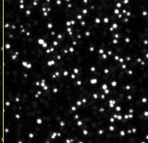
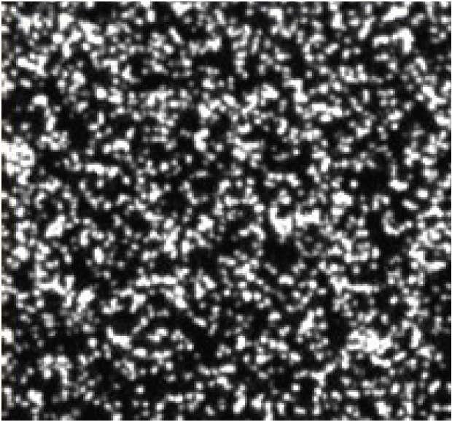
Library prep QC - Concentration
Why is an accurate concentration important?
Individual samples: to pool equal amounts of different samples together
  Aim for an even amount of sequencing data per sample
Final library: sequencer requires loading with a very precise concentration
  If concentration is overestimated (actual conc. is lower than what you think)
    Underloading and underclustering of sequencing run
    Sequencing run will yield less sequencing data than usual
  If concentration is underestimated (actual conc. is higher than what you think)
    Overloading and overclustering of sequencing run
    Sequencing run will suffer from higher error rates and reduced data output
Underloaded
Overloaded

Slide 6
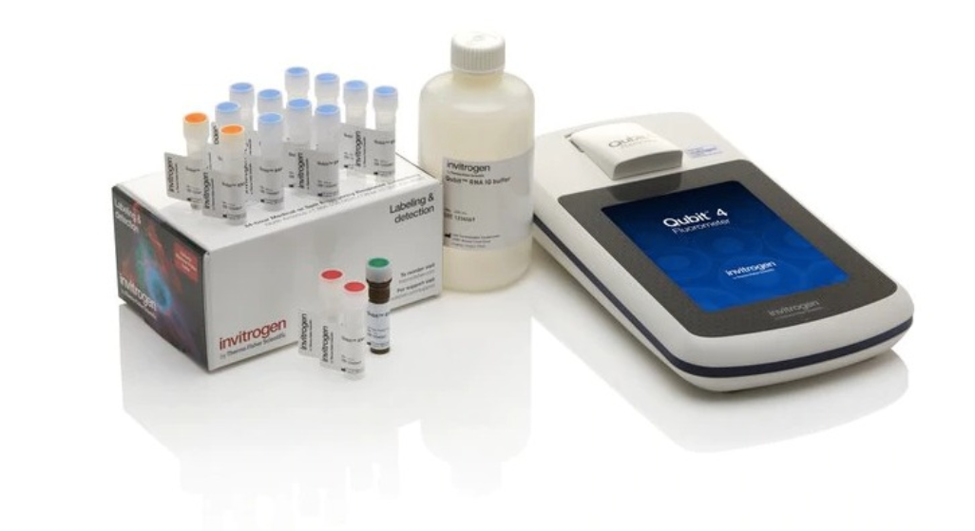
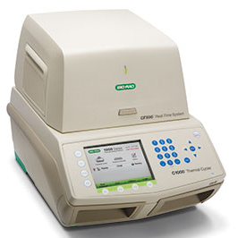
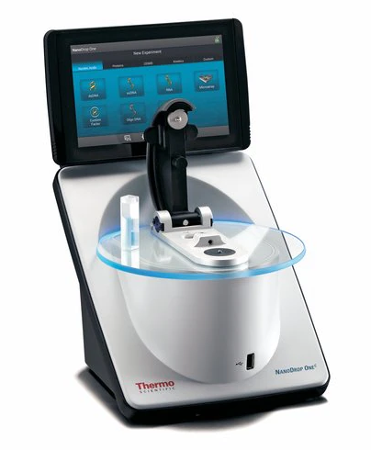
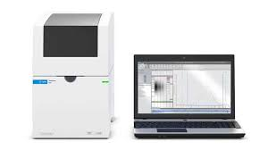
Library prep QC - Concentration
Fluorometry
(e.g. Qubit, qPCR)
DO NOT USE to quantify libraries
Spectrophotometry
(e.g. Nanodrop)
Detects fluorescent dyes that only bind DNA
Most reliable method for NGS
DNA absorbs light most strongly at 260 nm
Level of absorbance ~ concentration of DNA
Electrophoresis
(e.g. Tapestation, Bioanalyzer)
BUT other molecules (RNA, proteins) & contaminants also absorb light at 260 nm, causing up to 10-fold overestimation of the DNA concentration!
Compare intensity of DNA bands to standards
Especially useful to determine concentration in certain fragment length range
Notes:
RNA, guanidine

Slide 7
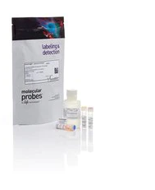
Library prep QC - Concentration
Qubit dsDNA High Sensitivity (HS) Assay kit
Prepare Working Solution:
  Diluting HS reagent 1:200 in HS buffer
Dilute in Working Solution:
  Standards: 10 μl standard + 190 μl Working Solution
  Samples: 1 μl sample + 199 μl Working Solution
Vortex 2-3 seconds before running standards/samples
dsDNA HS Reagent (200x concentrate)
dsDNA HS Buffer
dsDNA HS Standard #1
dsDNA HS Standard #2

Slide 8
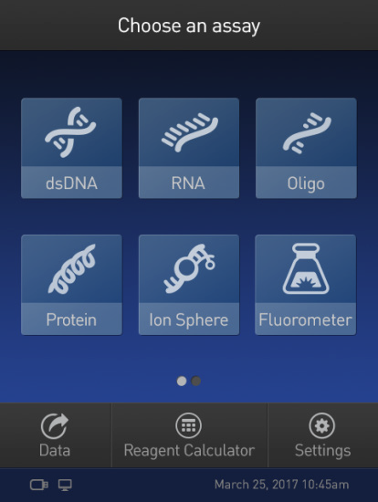
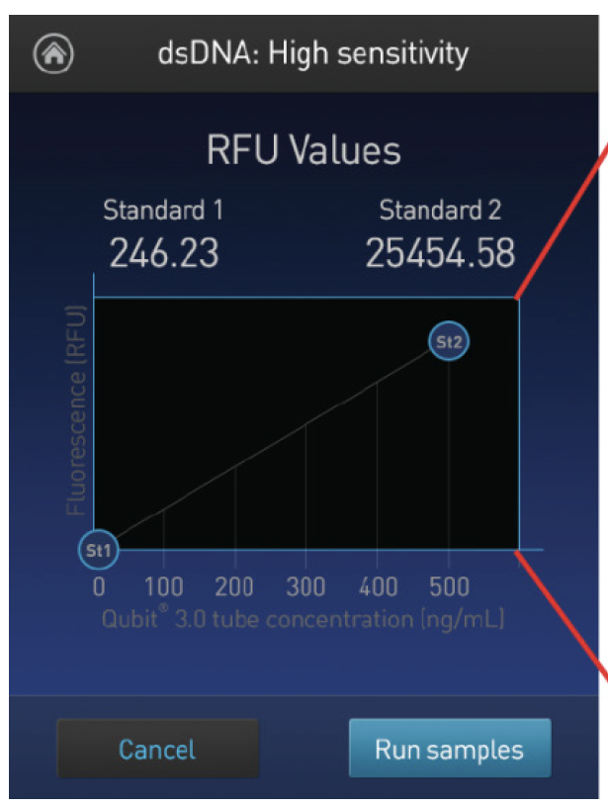
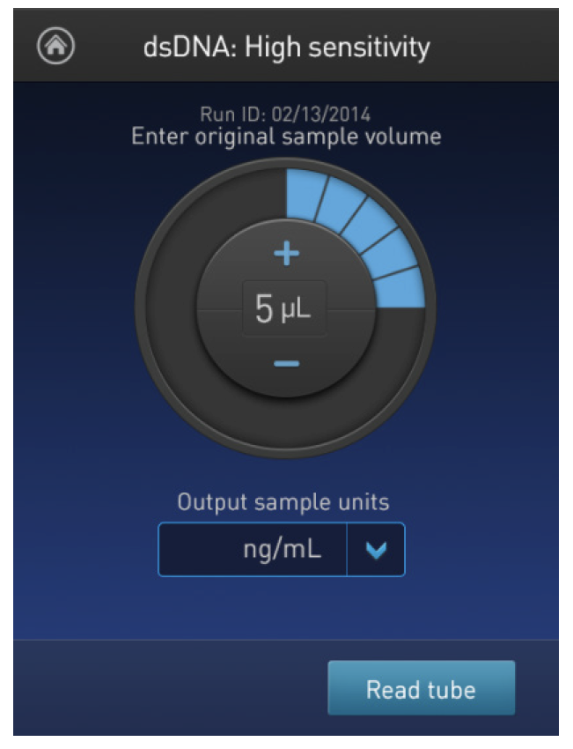
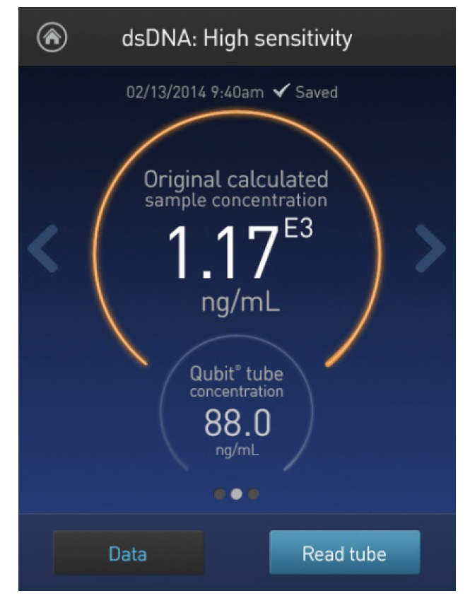
Library prep QC - Concentration
Qubit dsDNA High Sensitivity (HS) Assay kit
Select dsDNA HS workflow
Run the 2 standards
Enter sample volume added to tube
Run sample
Top value = original conc.
Bottom value = diluted conc.
We recommend keeping a log of the RFU values every time the standards are measured. Over time the fluorescence decays and can inadvertently give erroneous quantifications

Slide 9
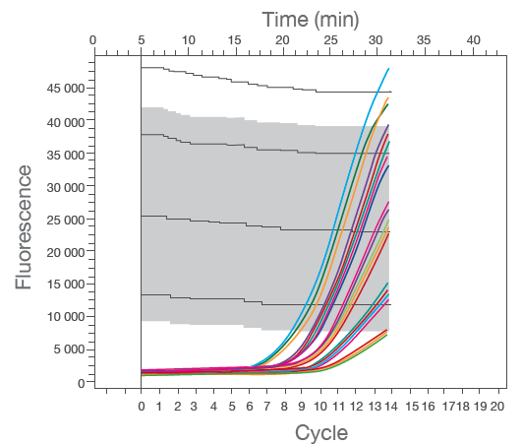
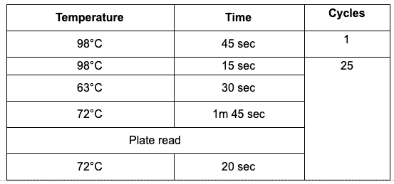
Library prep QC - Concentration
What if the concentration is too low?
  In future runs, consider adding more cycles to the indexing PCR step
  Amplify library using P5/P7 primers and qPCR-based library amplification kit
Set up qPCR reaction: library + mastermix + P5/P7 primers
Treat standards as separate samples (do not add mastermix)
Start run
Pause cycler during the 20s at 72°C step when a sample crossed the Standard 2 line, remove the sample and continue amplification for other samples
After amplification, perform bead cleanup on amplified libraries and QC again
Standard 4
Standard 3
Standard 2
Standard 1

Slide 10
Library prep QC
Concentration
Length
Remove adapter dimers
vs
vs
vs
or

Slide 11
Library prep QC - Length
Why is it important to assess fragment length in a library?
Long fragments (>1.2 kb) do not cluster on Illumina flow cells and are therefore not sequenced
Short fragments are preferentially amplified (better clustering) and will thus be preferentially sequenced
Fragment length distribution impacts calculations to go from ng/μl (Qubit) to nM for loading concentrations
Qubit
concentration in ng/μl
Concentration in nM =
x 10⁶
660g/mol x average library size in bp
Capillary or gel electrophoresis

Slide 12
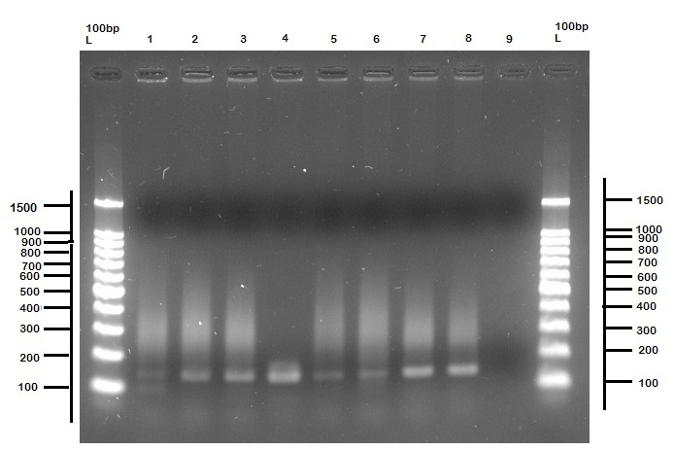
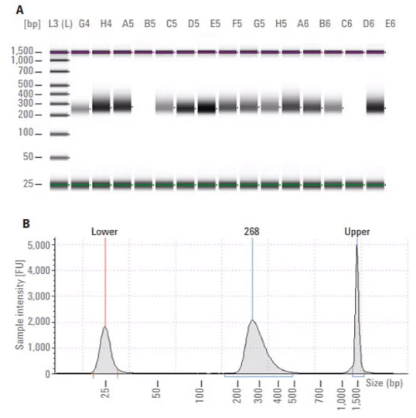
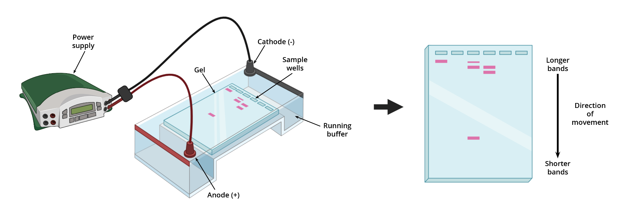
Library prep QC - Length
Gel electrophoresis
Capillary electrophoresis
E.g. Tapestation, Bioanalyzer
PCR amplify an aliquot of the library using universal P5/P7 Illumina primers
Gel electrophoresis of ladder and samples
Add buffer to aliquot of library
Run machine
Tapestation ~ 10 minutes (depending on # samples)
Bioanalyzer ~ 45 minutes
No PCR bias
Can calculate concentration in nM
Takes ~ 4 hrs

Slide 13
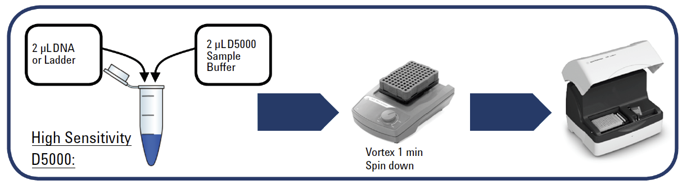
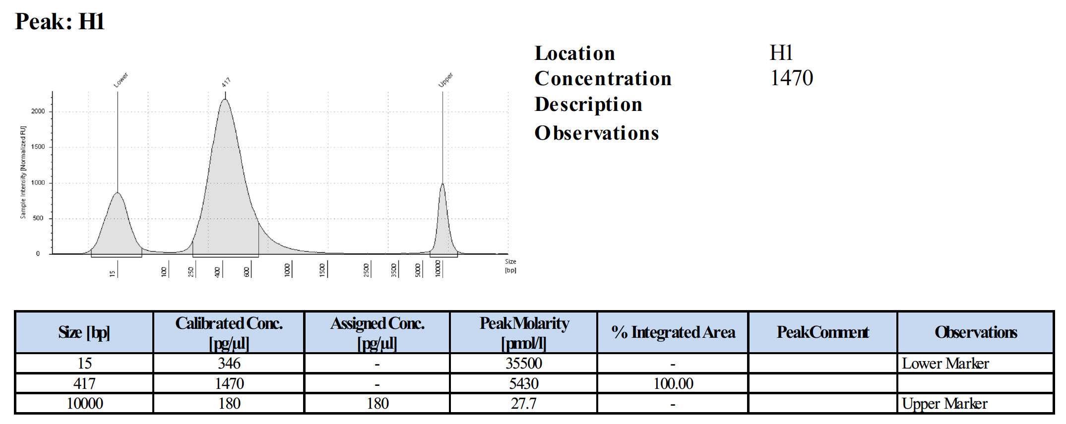
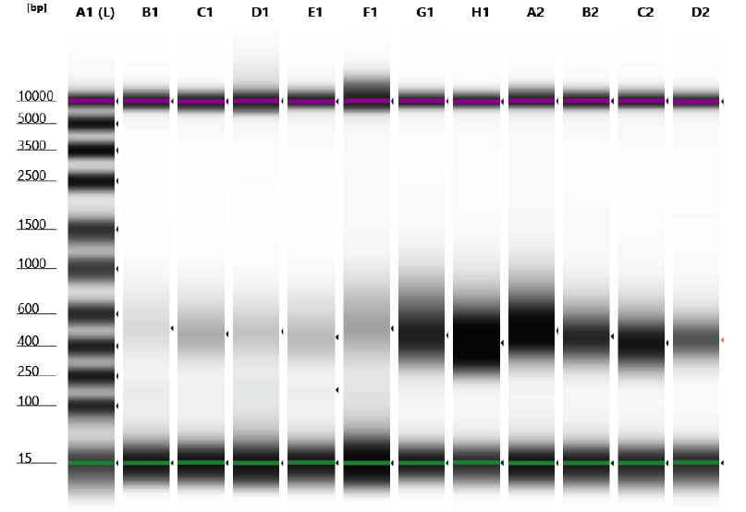
Library prep QC - Length
Tapestation
High Sensitivity D1000 or D5000 kits (1kb or 5kb detection limit)

Slide 14
Library prep QC
Concentration
Length
Remove adapter dimers
vs
vs
vs
or

Slide 15
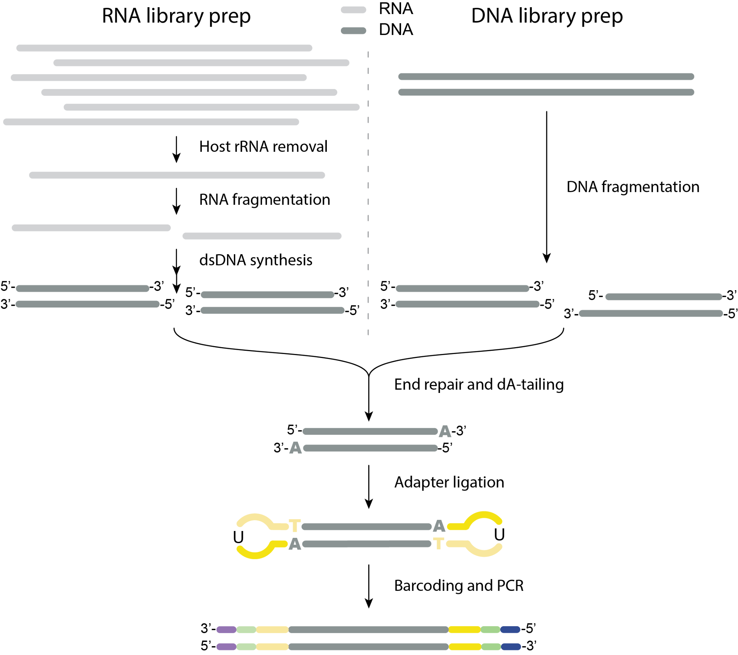

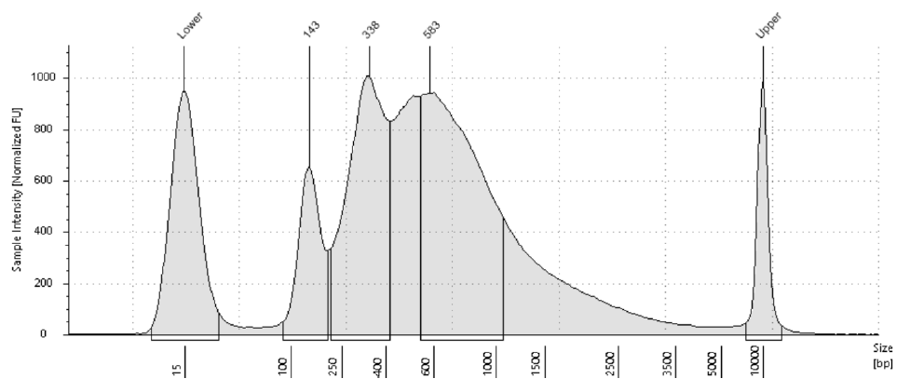
Library prep QC - Clean up adapter dimers
Adapter dimers are:
  A byproduct of the adapter ligation step during library prep (TruSeq/NEBNext Ultra II DNA kits)
  ± 140 bp long at the final QC step (after barcoding PCR)
  Use capillary electrophoresis (preferred) or PCR + gel electrophoresis to detect adapter dimers
Adapter dimers

Slide 16
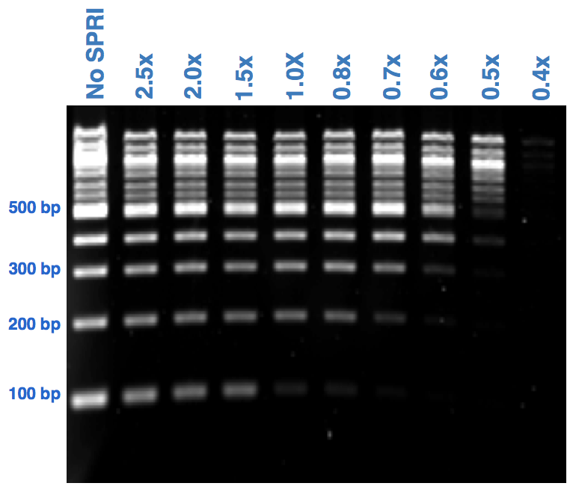
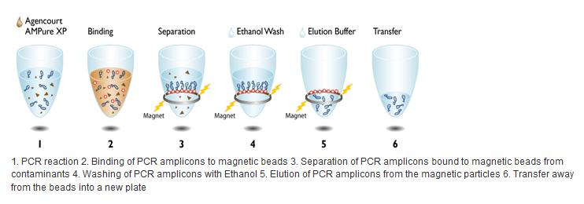
Library prep QC - Clean up adapter dimers
AMPure XP SPRI select beads (paramagnetic)
or homemade SPRI beads (>10x cheaper)
The longer a fragment, the better it will bind to the beads
The fewer beads you add, the more short fragments you’ll lose
Perform size selection using these beads to remove adapter dimers
Volume beads
Volume reaction
SPRI ratio =
Example: for a 1.8x SPRI clean-up:
Add 18 μl of SPRI beads to 10 μl of sample

Slide 17
Library prep QC - Clean up adapter dimers
AMPure XP SPRI select beads (paramagnetic)
Size selection using beads to remove adapter dimers
Rule of thumb: if you see a clear trace of adapter dimers, performs another round of cleanup
Step | To remove | SPRI ratio
After adapter ligation | Adapter dimers (64 bp) & reagents | 0.9x
After P7/P5 PCR | P5-adapter dimer-P7 (143 bp) & reagents | 0.8x
QC of library | P5-Adapter dimer-P7 (143 bp) | 0.8x
Notes:
Adapter dimers should be less than 1% of your total library
P7: 24 nt p7 + 12 nt barcode + 2 nt + 32 nt adapter compl.
P5: 20 nt p5 + 9 nt +12 nt barcode + 33 nt adapter compl.

Slide 18
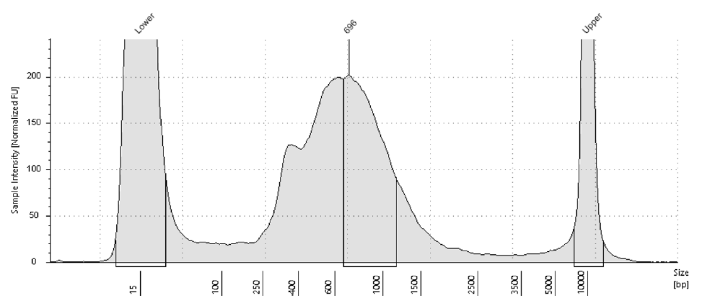
Library prep QC - Clean up adapter dimers
AMPure XP SPRI select beads (paramagnetic)
Size selection using SPRI beads to remove adapter dimers
Rule of thumb: if you see a clear trace of adapter dimers, performs another round of cleanup
After PCR amplification
After SPRI bead clean-up
3 rounds
SPRI (0.85x)
Adapter dimers
ALL DIMERS SHOULD BE REMOVED!
Notes:
Adapter dimers should be less than 1% of your total library
P7: 24 nt p7 + 12 nt barcode + 2 nt + 32 nt adapter compl.
P5: 20 nt p5 + 9 nt +12 nt barcode + 33 nt adapter compl.

Slide 19
Library prep QC
How to fix samples with QC issues?
Concentration too low -> amplify or restart
Adapter dimers -> perform additional cleanups
Fix it
NO
Sample A
Individual library QC passed?
Fix it
YES
NO
YES
Final QC
passed?
Individual library QC passed?
Pool
YES
Sample B
YES
Water control A
Individual library QC passed?
Notes:
Two moments during lib prep to do QC: individual library and pooled library

Slide 20
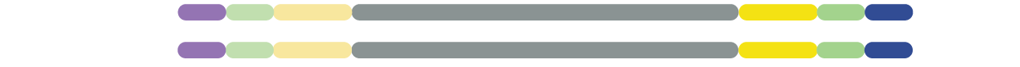
Library prep QC
Pooling samples for sequencing
Each sample has a unique set of barcodes -> multiple samples can be pooled in one sequencing reaction
QCed Sample A
BC2
BC1
QCed
Sample B
BC4
BC3
Final QC & seq prep
Pool
QCed
Water control A
BC6
BC5
Notes:
Every sample has its own set of barcodes, so everything can be pooled.

Slide 21
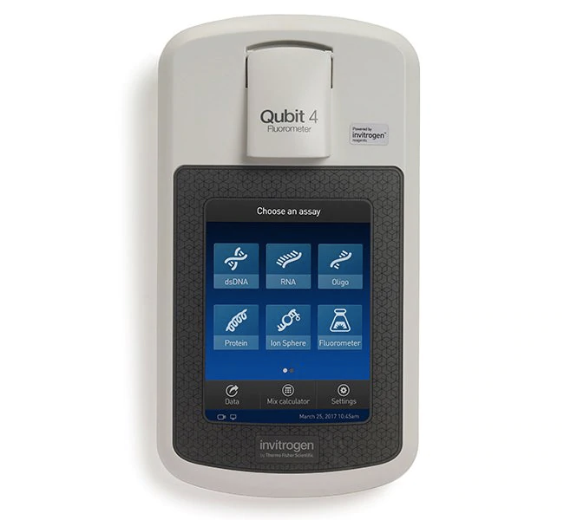
Library prep QC
Pooling samples together for sequencing
  Qubit to determine concentration of individual libraries (expect library to be 0.5 to 10 ng/ul)
  Pool barcoded libraries so that all are equally represented (except H₂O controls, only 1:5)
Qubit concentration
Pool
Sample 1: 10 ng/ul -> 4.0 μl -> 40 ng
Sample 2: 5 ng/ul -> 8.0 μl -> 40 ng
Sample 3: 8 ng/ul -> 5.0 μl -> 40 ng
Sample 4: 15 ng/ul -> 2.6 μl -> 40 ng
H₂O control: 1 ng/ul -> 8.0 μl -> 8 ng
Total: 27.6 μl
168 ng
End goal is >10 μl of 2 nM pooled library (or 4 nM for MiSeq)
Pooling guidelines
Do not pool more than half of your library volume (in case you need to go back)
Pool waters/negative controls less mass than samples (1/5th or 1/10th)
Notes:
10 ng/ul would be a lot for a library -> tone down PCR cycles next time

Slide 22
Library prep QC
Pick one way to calculate nM and stick with it!
Qubit concentration and library size
or
Automatic calculation by Tapestation
Pooling samples together for sequencing
3. After pooling, determine quantity and quality of pool
Qubit
concentration in ng/μl
Concentration in nM =
x 10⁶
660g/mol x average library size in bp
Capillary or gel electrophoresis
Example: if concentration is 6.1 ng/μl, and average library size is 550 bp -> concentration is 16.8 nM
End goal is >10 μl of 2 nM pooled library

Slide 23
Library prep - preparing to load the sequencer
Dilute library to the correct loading concentration:
  iSeq:
    dilute to 75 pM (or another optimized concentration)
    Spike in 1-5% of PhiX at the same concentration
  MiSeq:
    First denature library with sodium hydroxide (NaOH)
    Then dilute to 10-12 pM (or another optimized concentration)
    Spike in 1-5% of denatured PhiX to denatured and diluted library
See slide decks for iSeq or MiSeq loading for more details!

Slide 24
Using the Tapestation

Slide 25
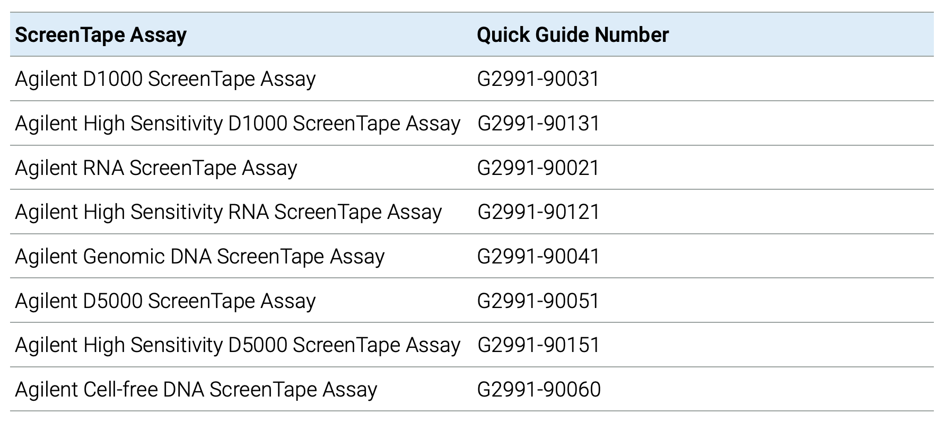
Choosing the right assay according to your starting material
RNA
500 – 10000 pg/µL
DNA
200 to >60000 bp, 10 – 100 ng/µL
Sequencing libraries
100 - 5,000 bp, 10 - 1,000 pg/µL
Note, sensitivity is guided by input concentration.

Slide 26
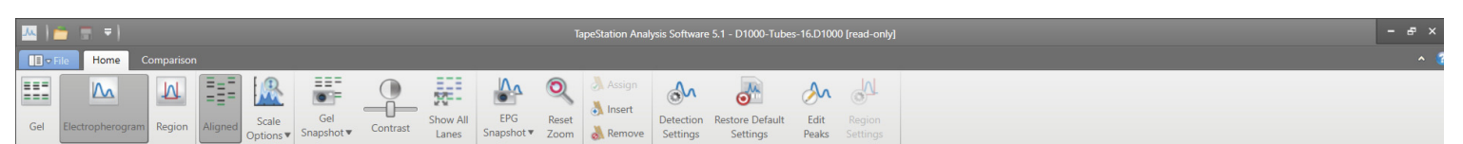
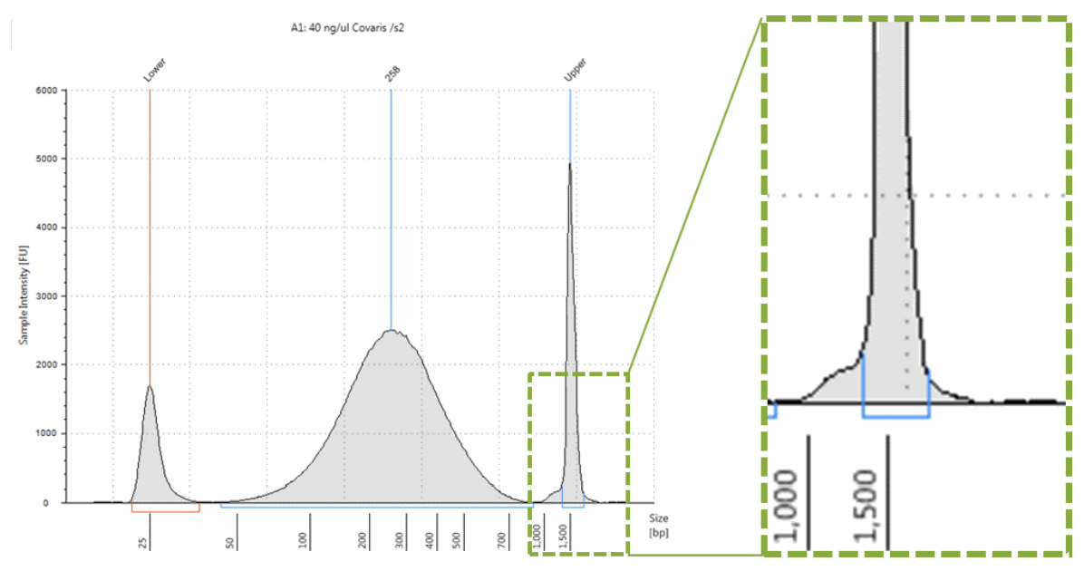
How to analyse a TapeStation run?
Ensure that all marker peaks (‘Lower’ and ‘Upper’) are properly assigned. Concentration values are calculated using the area of the sample peak compared to the known concentration of the upper marker.

Slide 27
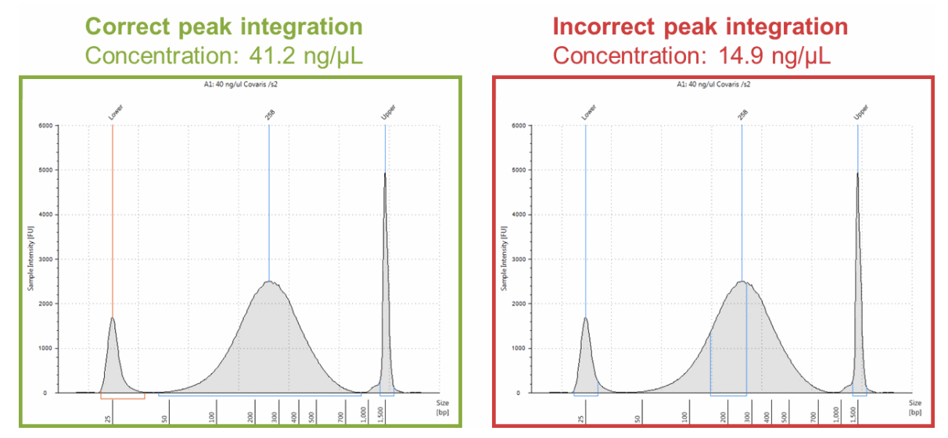
How to analyse a TapeStation run?
Ensure that all marker peaks (‘Lower’ and ‘Upper’) are properly assigned. Concentration values are calculated using the area of the sample peak compared to the known concentration of the upper marker.
Ensure that sample peaks are properly integrated by manually adjusting the peak when necessary.

Slide 28
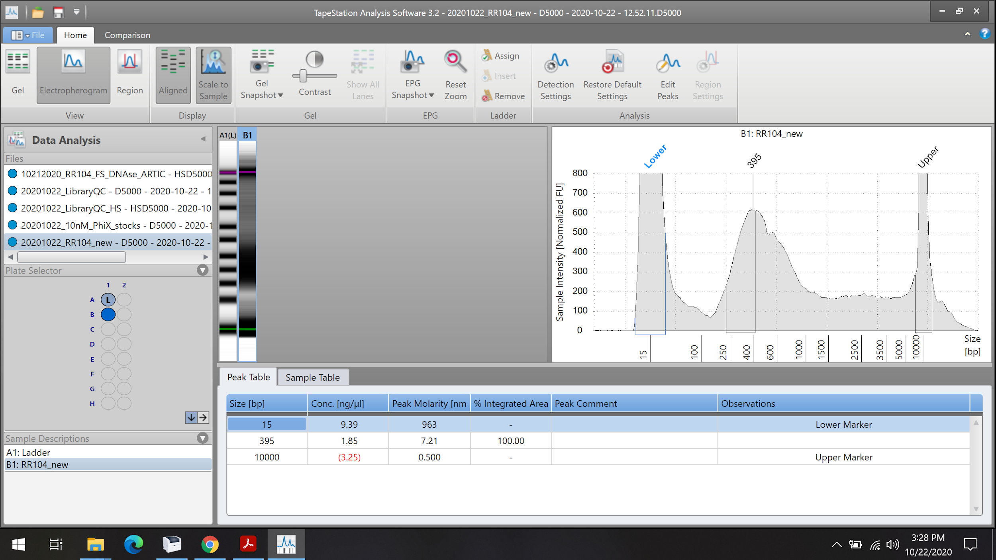
This is the “Electropherogram” view setting. If you see this after the TS analysis ends, click on “Region”

Slide 29
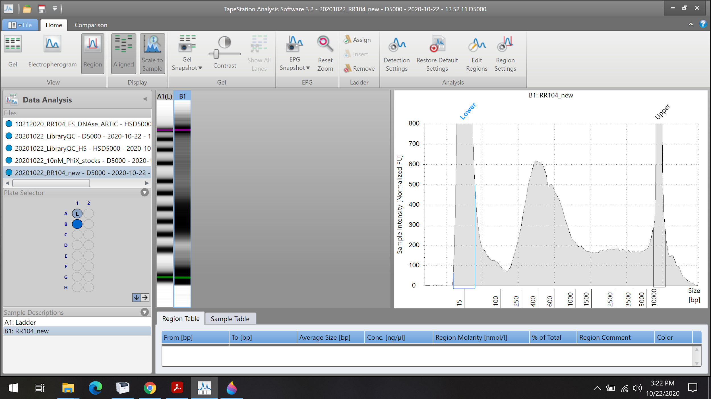
Click on “Region Settings”

Slide 30
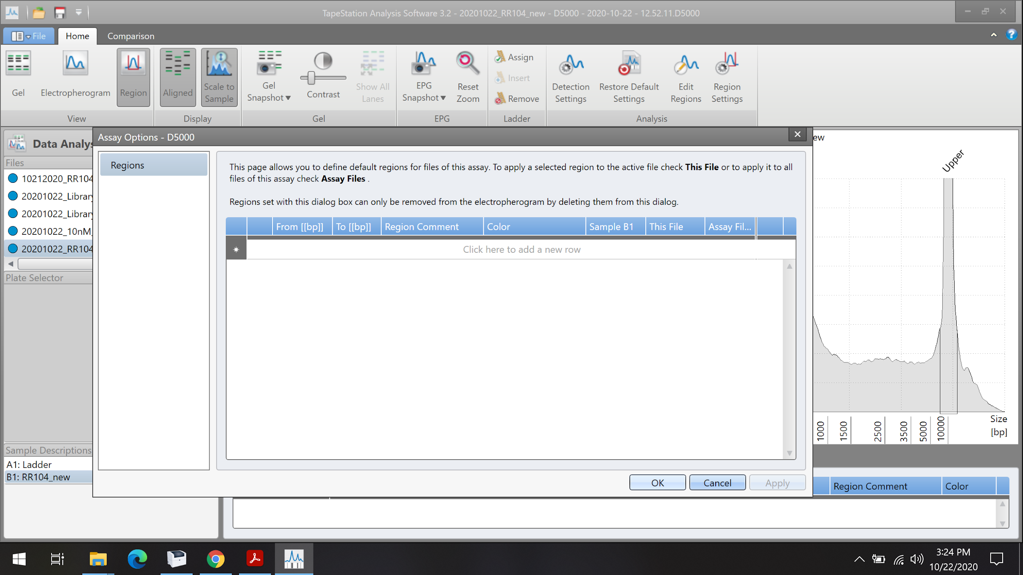
Click on this line to add the peak range of interest

Slide 31
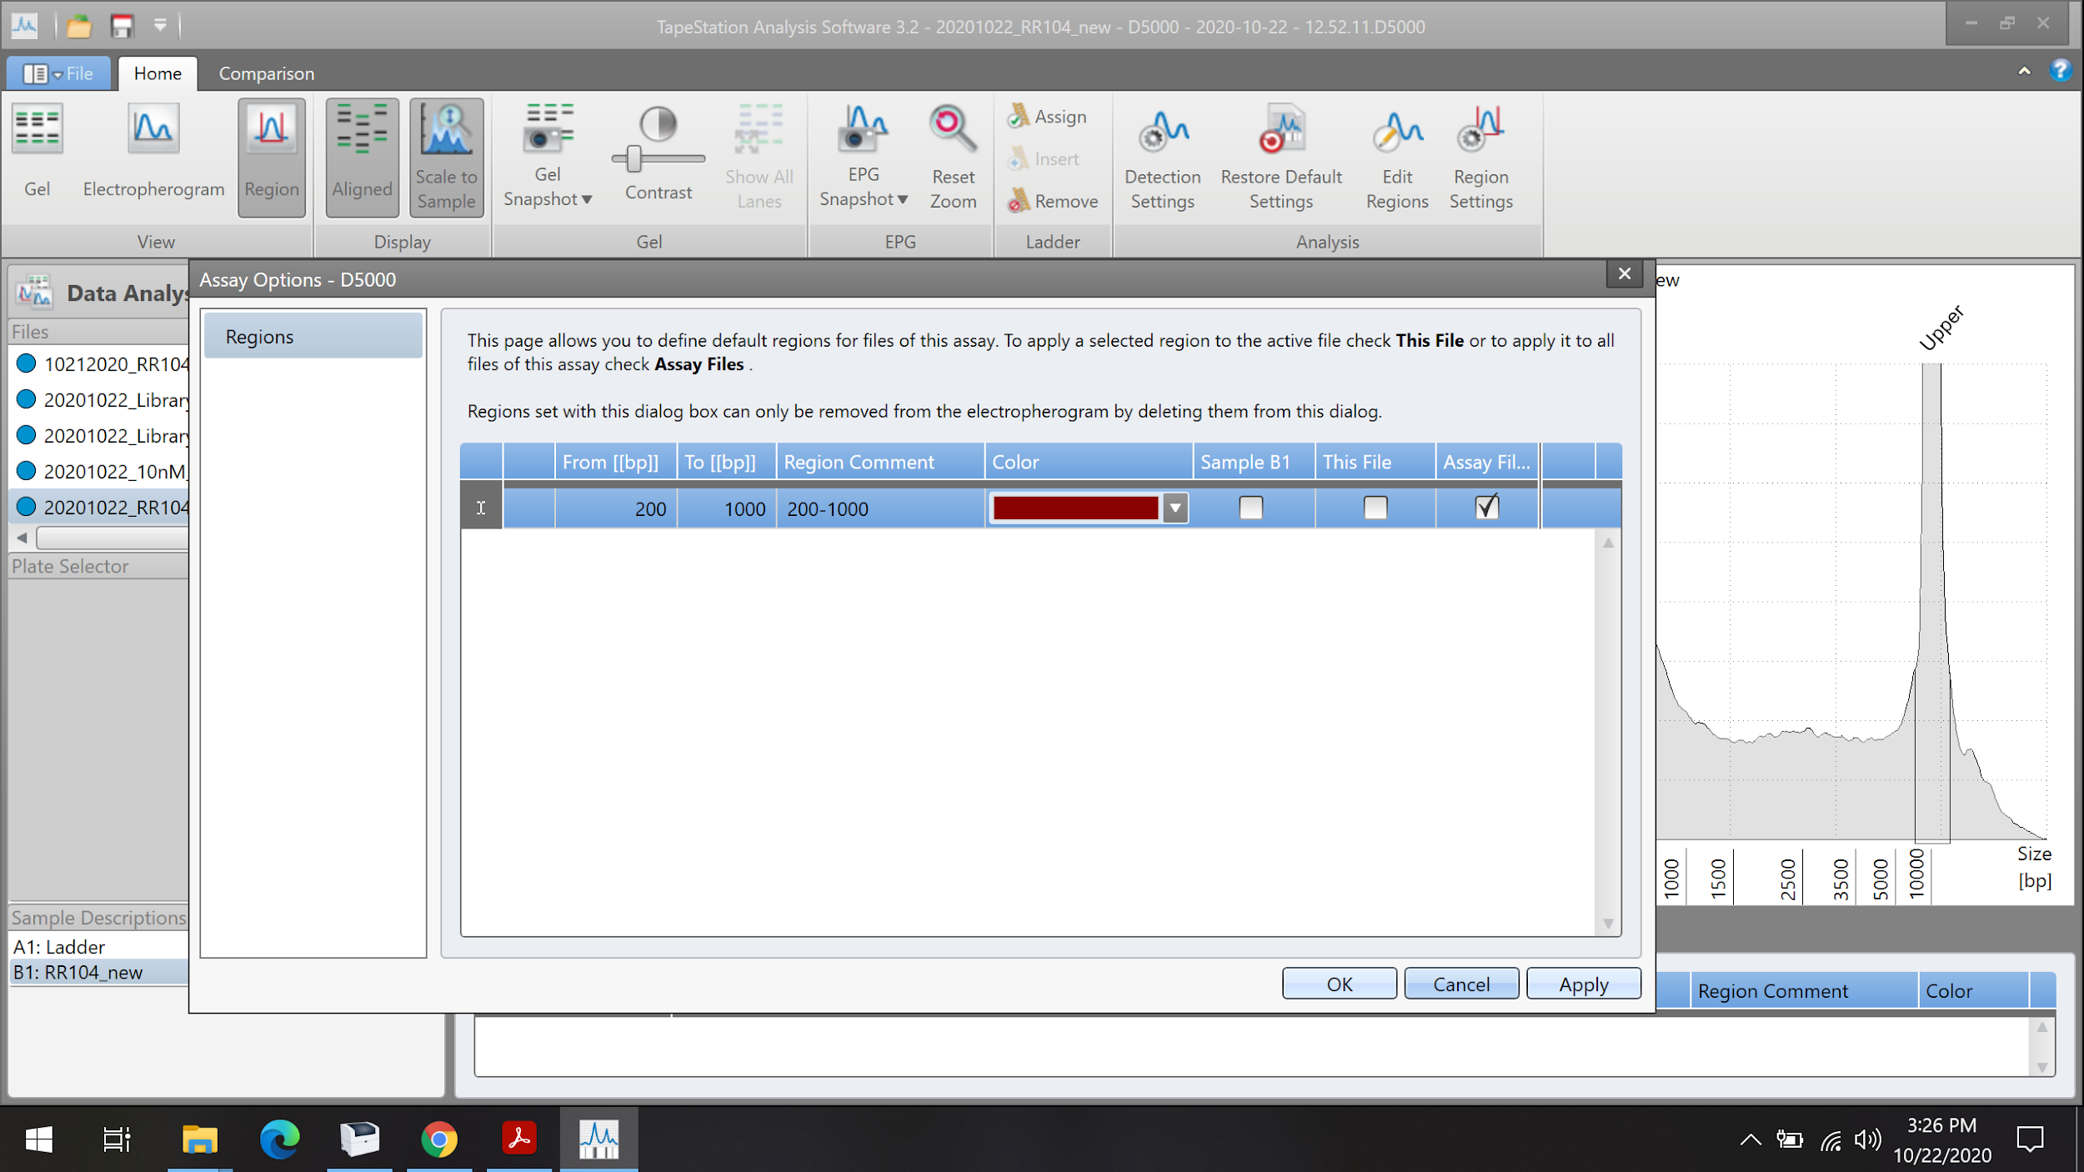
By selecting “assay file” this range will apply to all future assays. But you can also specify the range for a sample or file.
Enter the “from” and “to” range here. We commonly use the 200-1000 bp range
Notes:
You can set multiple peak ranges as well

Slide 32
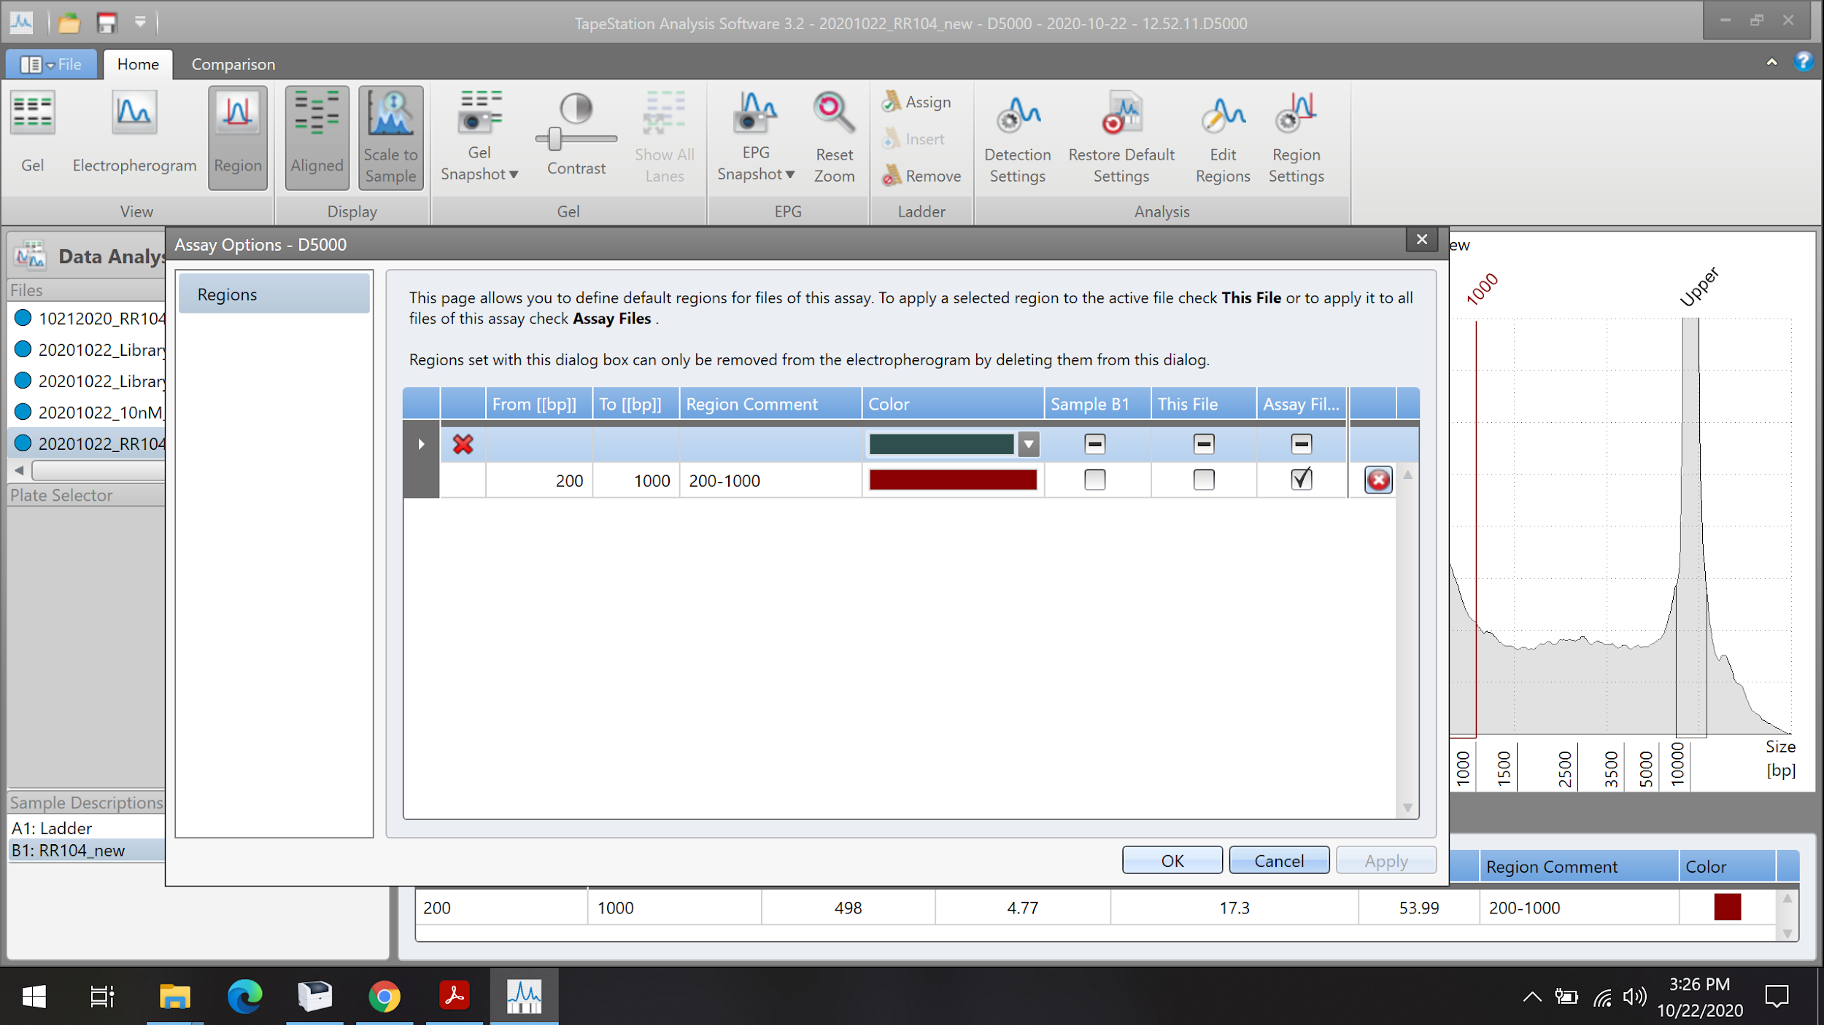
Click “Apply”

Slide 33
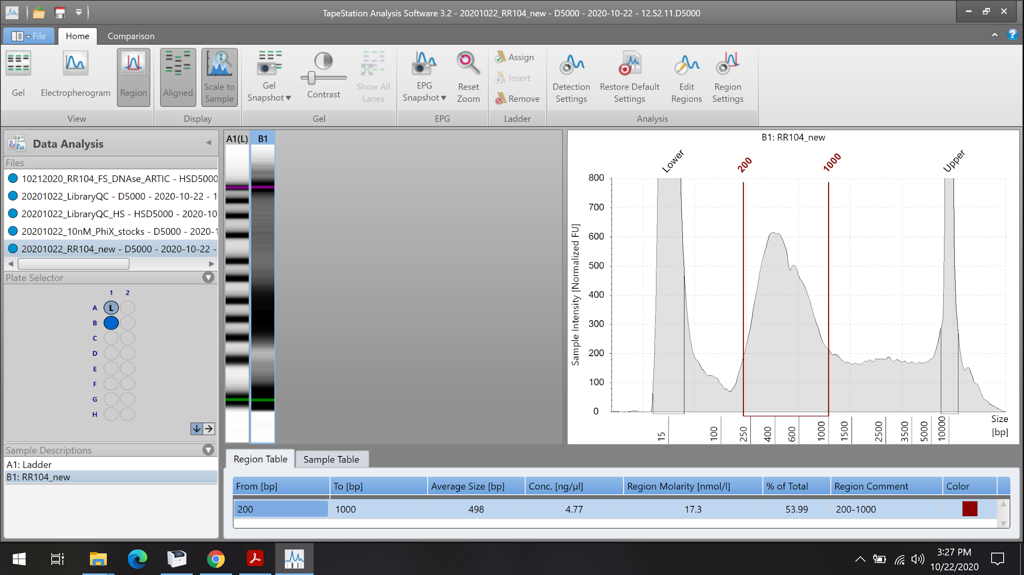
The “Region Molarity” concentration is now based on the 200-1000 bp range selected. This is the TS value that we use for our sample quantification

Slide 34
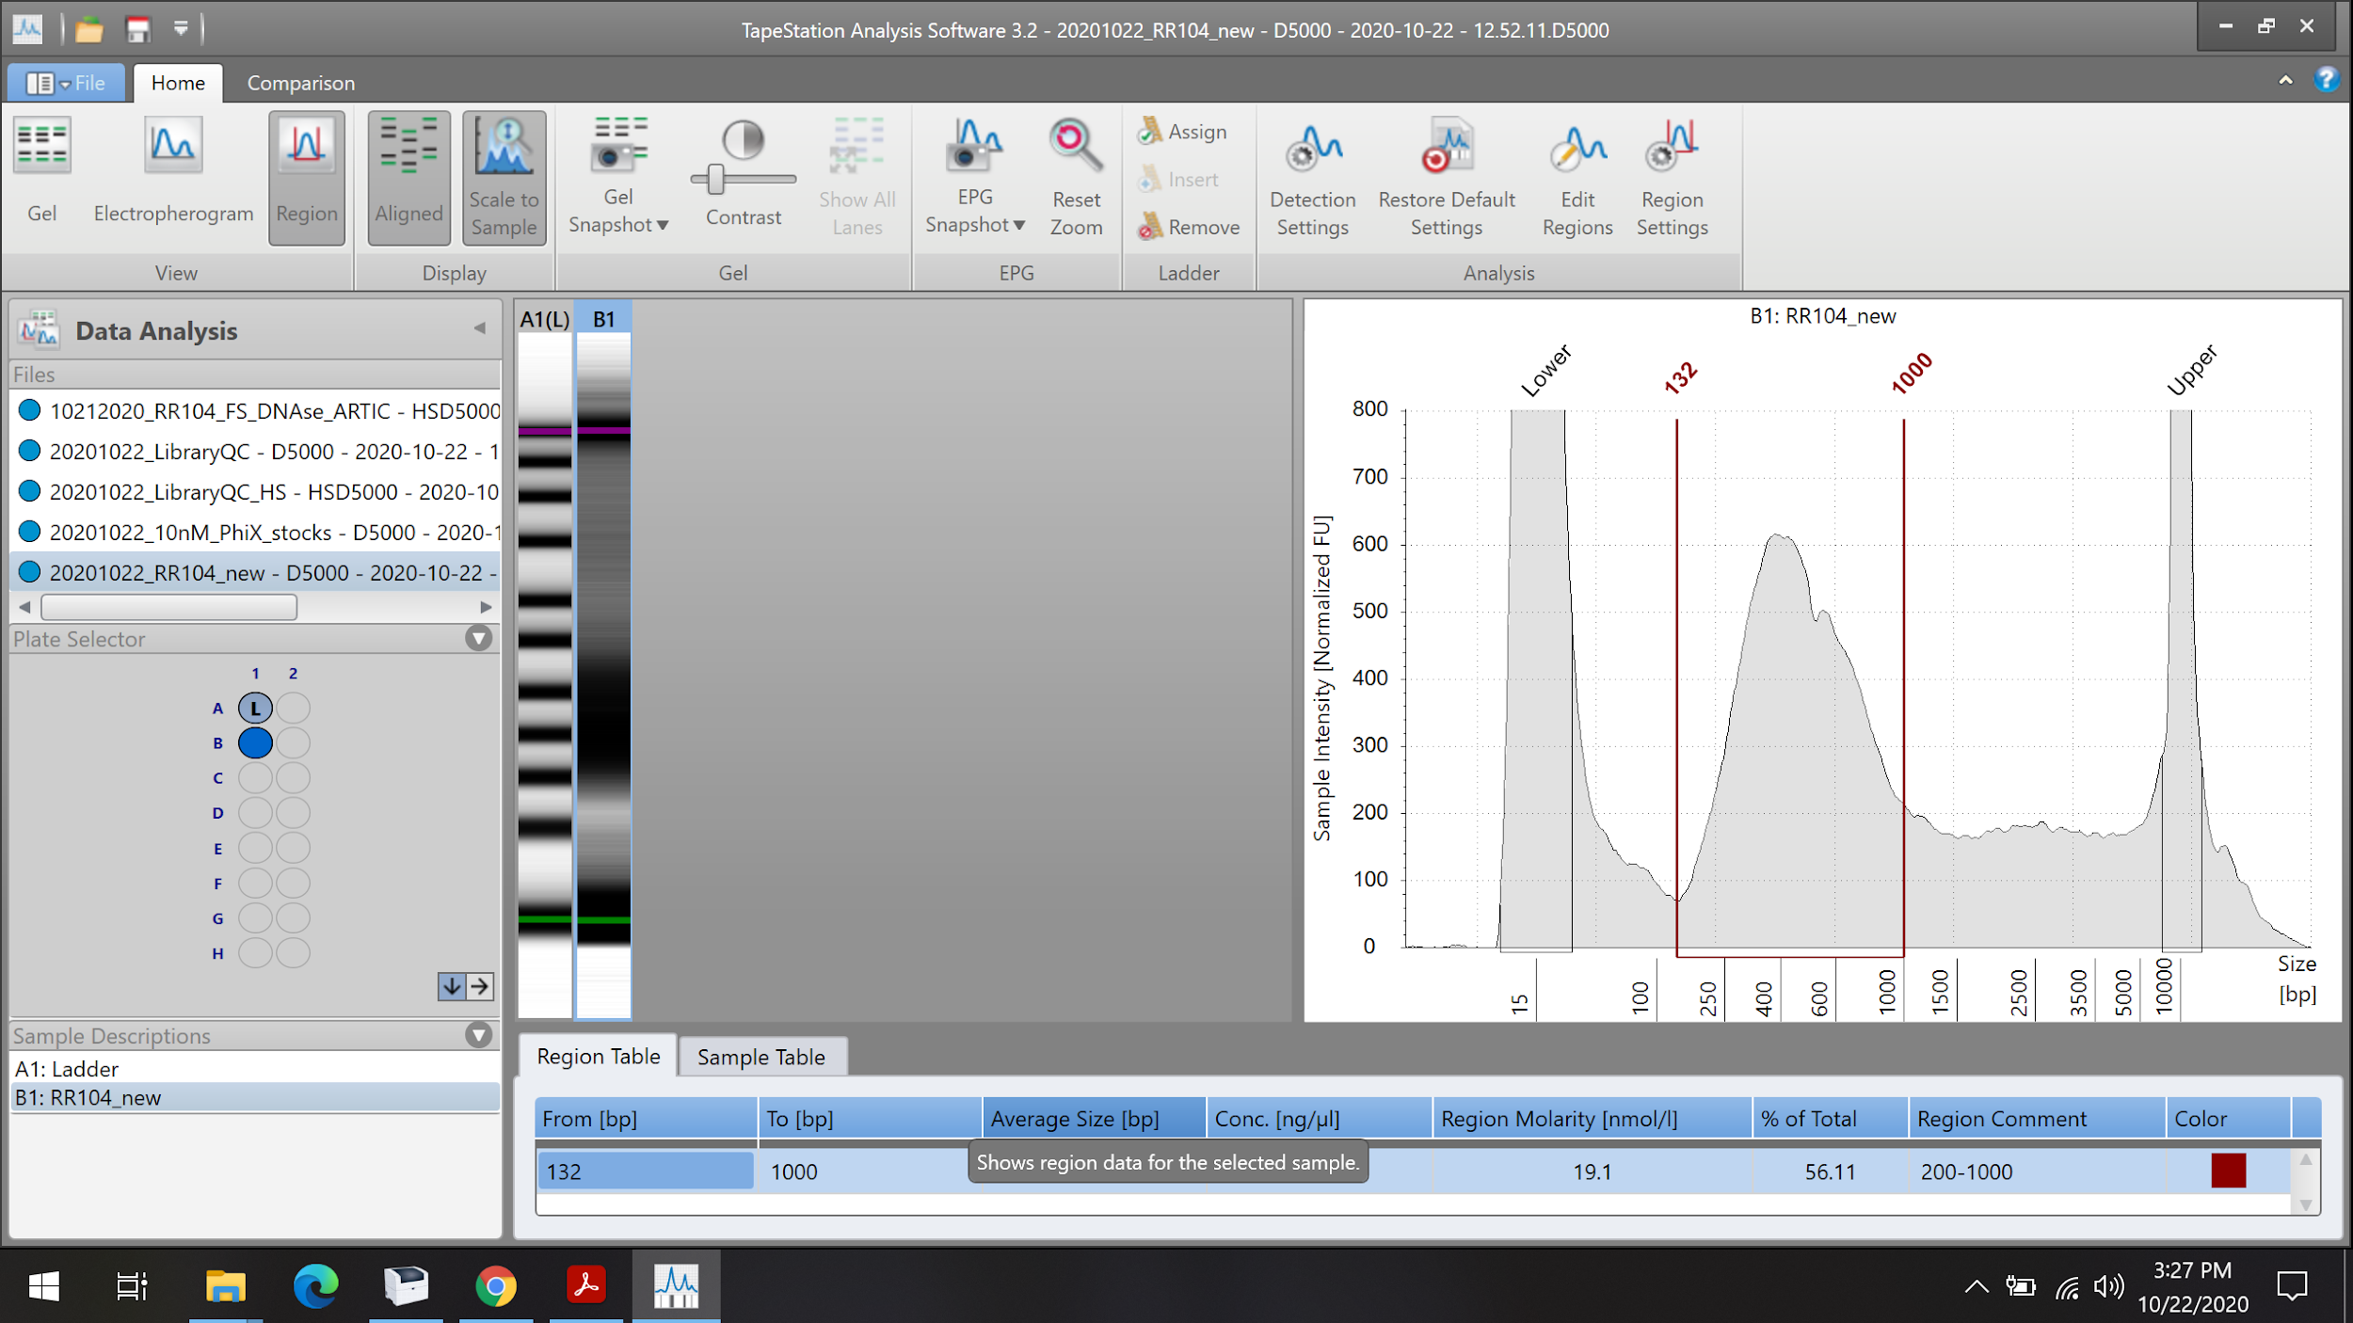
You can click and drag the peak range vertical line to make adjustments. In this case, we shifted the line from 200 bp to 132 bp to take into account shorter fragments. Region molarity is automatically recalculated.

Slide 35
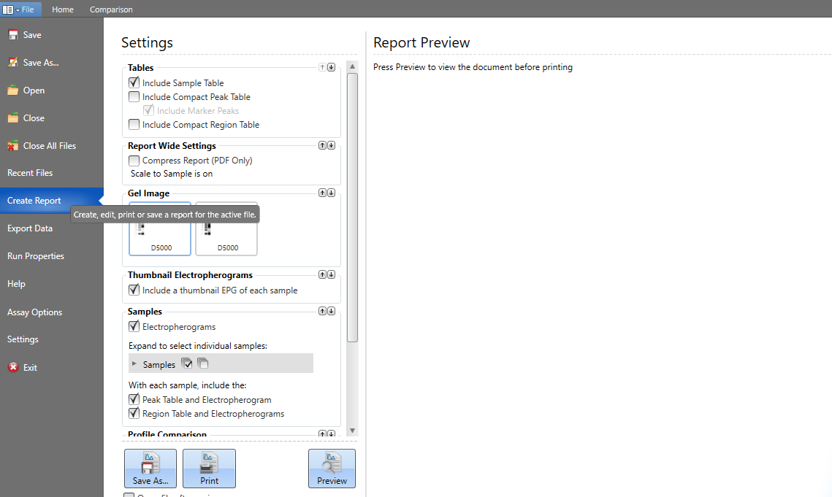
When you click on file this window will open. Click on “Create report” on the left panel in the purple box. That will create the report in pdf which is now you can save by clicking on “Save As…” in brown box. This will create the pdf report wich is amenable to view in other computers

Slide 36
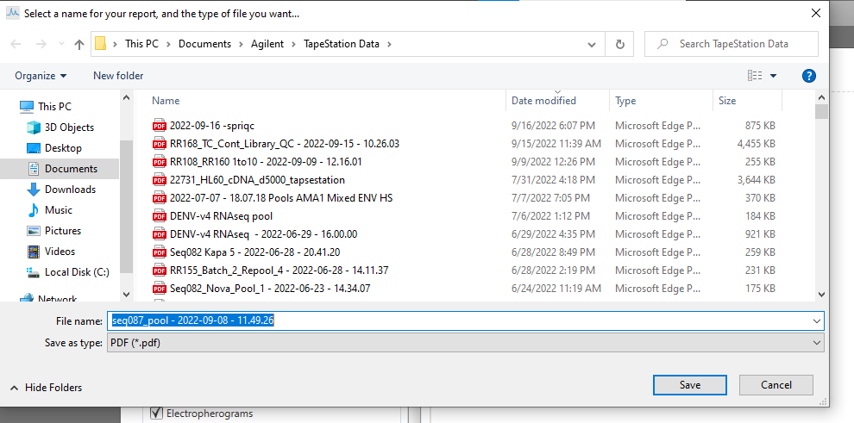
Save and now your report is ready to share as a pdf!

